Slide 1
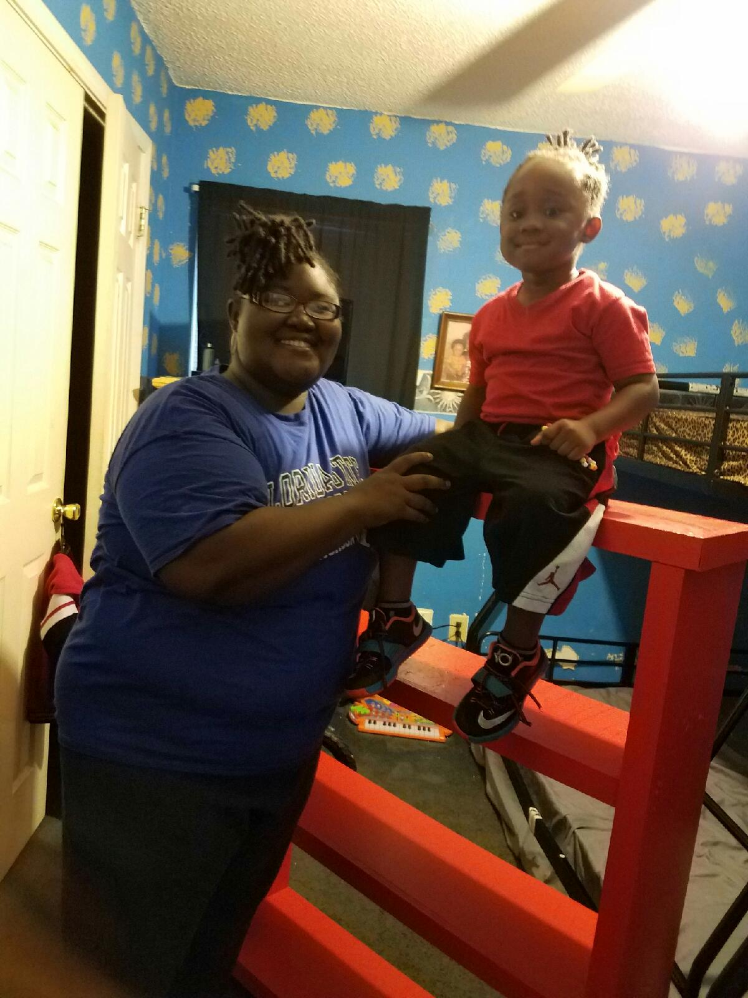
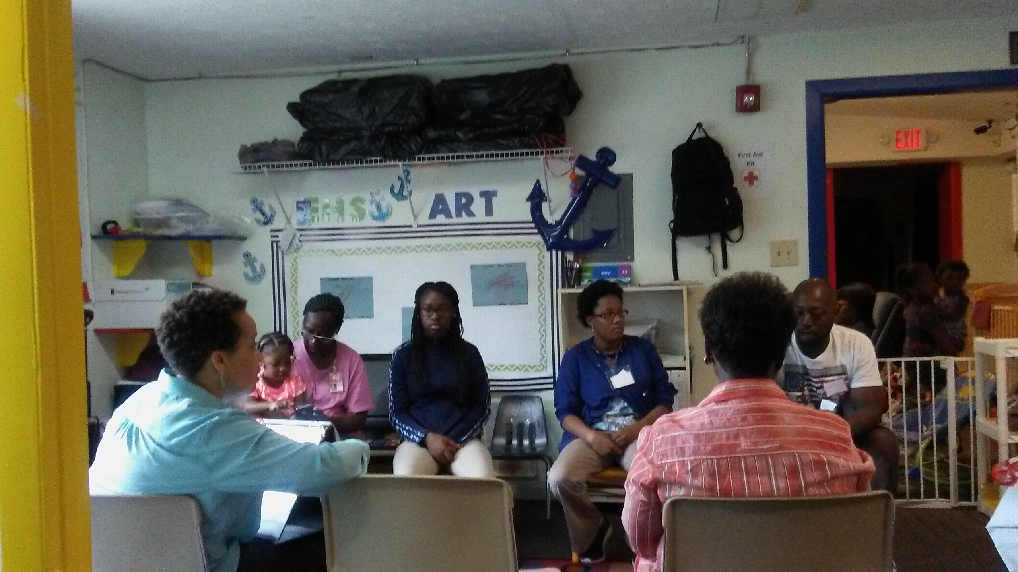
Projects Committee completed 2nd Project IMPACT series at Pearson Head Start Center. Ms. Jones attended all sessions and received a red bookshelf and mini-library for her son, age 3.
Sessions completed at Young Legends Center and Pearson Head Start Center.

